Slide 1
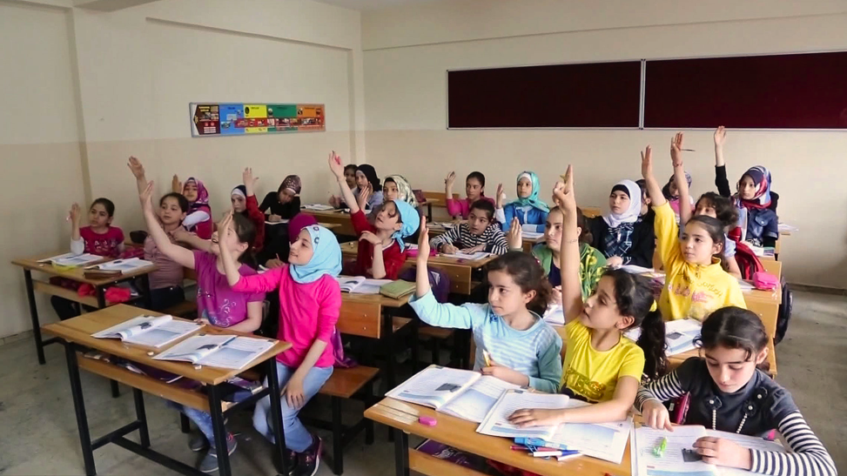
Best Practices, School-wide and Classroom, for Newcomer Inclusion
Mary Lou McCloskey, PhD
mlmccloskey@gmail.com
www.mlmcc.com (Handouts)
Amy Pelissero, PhD
amypelissero@globalvillageproject.org
www.globalvillageproject.org
Notes:
0

Slide 2
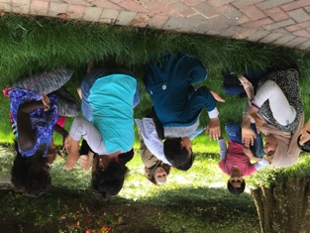
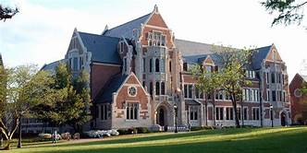



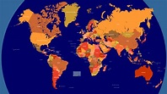
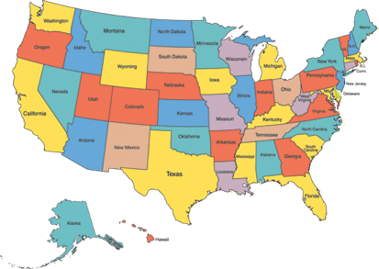
Mary Lou McCloskey: A brief Introduction
Professor
ESOL Specialist
Past President of TESOL
Experienced in 39 countries and 26 US states
Working with refugees for 34 years
Notes:
Part-time Professor at Agnes Scott College
ESOL Specialist at The Global Village Project
Past President of International Teachers of English to Speakers of Other Languages
Experienced working with administrators, teachers and students in 39 countries and 26 US states
Working with refugees for 25 years

Slide 3
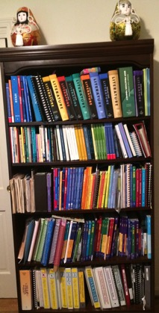
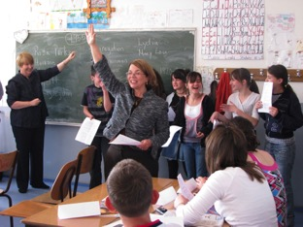
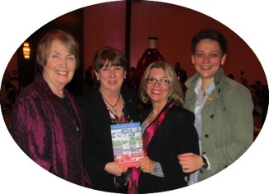
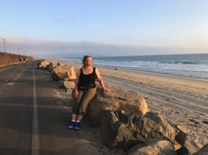
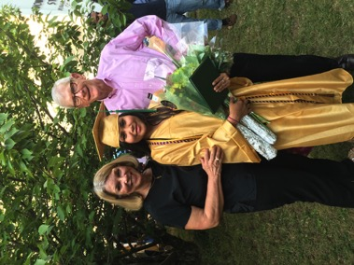
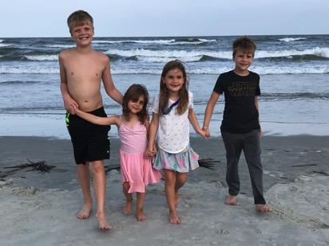
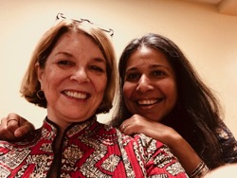
Mary Lou McCloskey: A brief Introduction
Author
Teacher
First time working in Greece
Mom, grandma, wife, sister, friend, mentor, hiker and explorer, reader, and maker
I have many things to share, but more to learn!
Notes:
Author of many textbooks, professional books and articles.
First a teacher, and continuing to teach often
Working in Greece for the first time, though I have travelled here
Mom, grandma, wife, sister, friend, mentor, hiker and explorer, reader, and maker
I have many things to share, but more to learn!

Slide 4
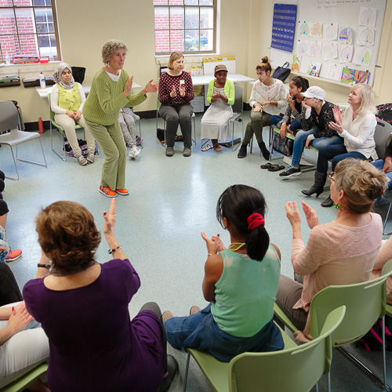
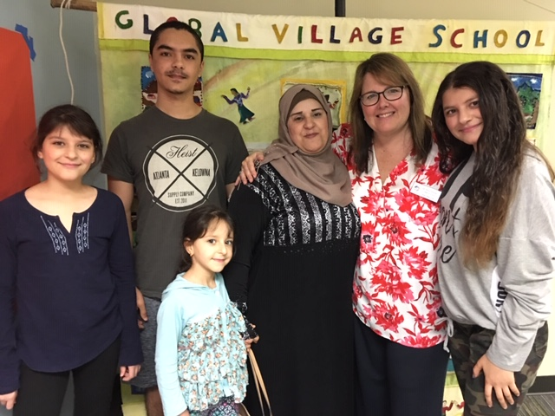
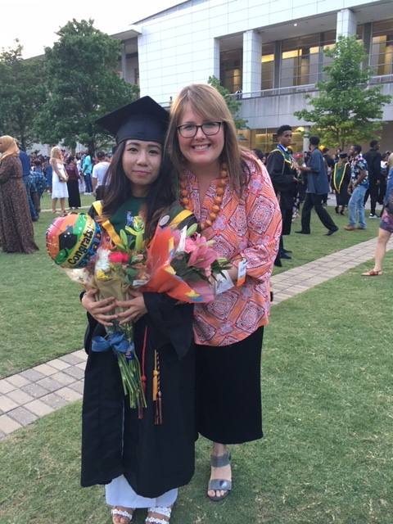
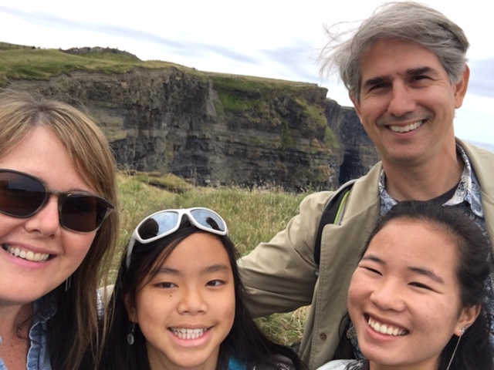
Amy Pelissero – A Brief Introduction
Teacher
10 years with Refugees
Head of School
Mentor
Researcher
Mother
Entrepreneur

Slide 5
The Global Village Project: An Introduction

Slide 6

Our Goals Today
To Introduce topics
and issues in working with migrant learners in Greece
To inspire deeper conversations to come
To provide resources for working with migrants in schools
Our ultimate goal – refugee learners’ success in reaching their dreams

Slide 7
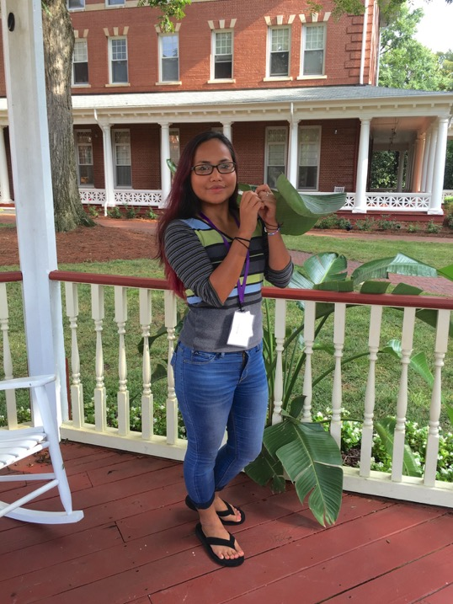
Success Story: Meh Sod (Karen from Burma)
“I believe my story would be the same as that of my parents without the Global Village Project. When I first arrived, I was having a very difficult time because of the new language and new culture. I was drowning in the water and had no boat to hold on to. But then, I was rescued by the Global Village Project, a place where people were always willing help me with my new beginning; a place that is full of inspiration to lead me to a brighter future. I am grateful for people who care so much.”
Meh Sod won a Gates Millenial Scholarship and is now in her third year at Agnes Scott College.

Slide 8

Four big questions:
Who are our migrant learners?
What do newcomers need?
How can we teach them effectively?
What other resources do we have or need?
Notes:
10

Slide 9
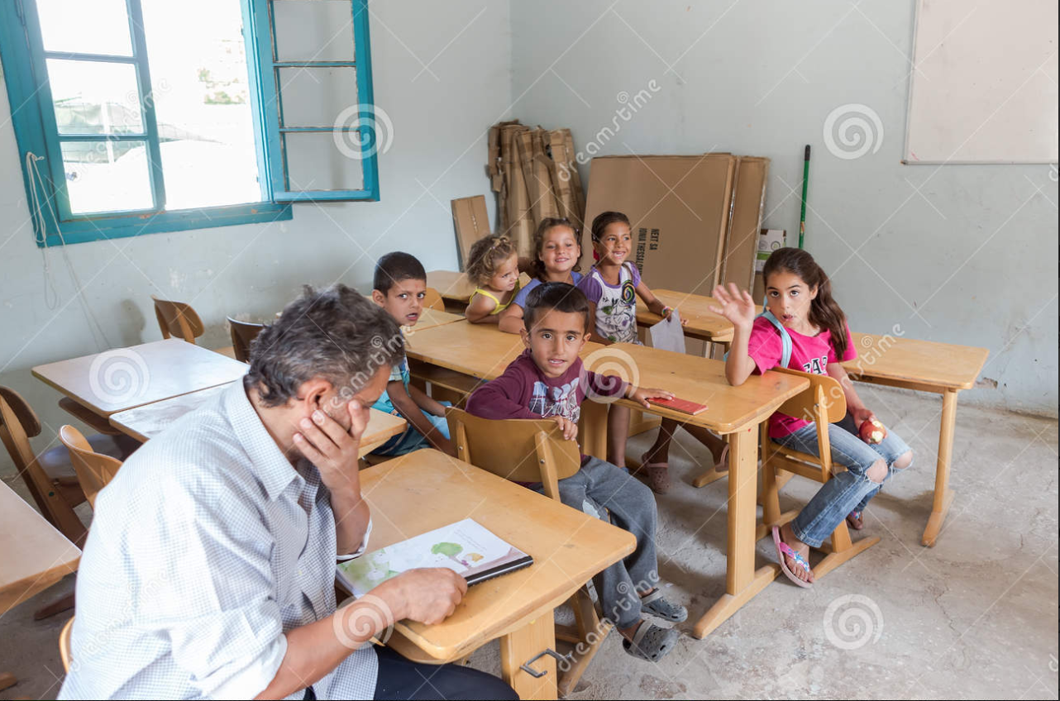
1. Who are our learners?
Dreamstime.com

Slide 10
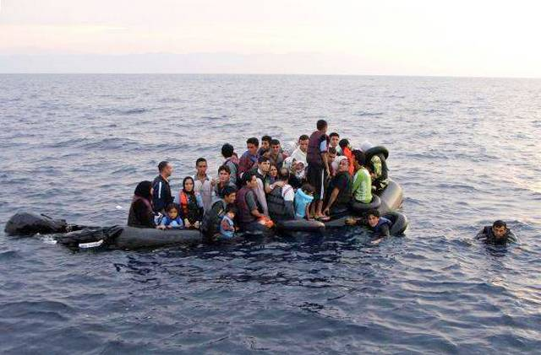
About the learners in Greece
Maybe 75,000 (?) refugees in Greece
About half of them (?) school-age
children.
Over 3510 unaccompanied students
in July, 2018 (UNHCR)
Students have interruptions to education averaging 18 months
Many migrants have no education at all; some highly educated in other languages.
Most are fleeing danger from Afghanistan, Iraq, Syria, and other countries

Slide 11
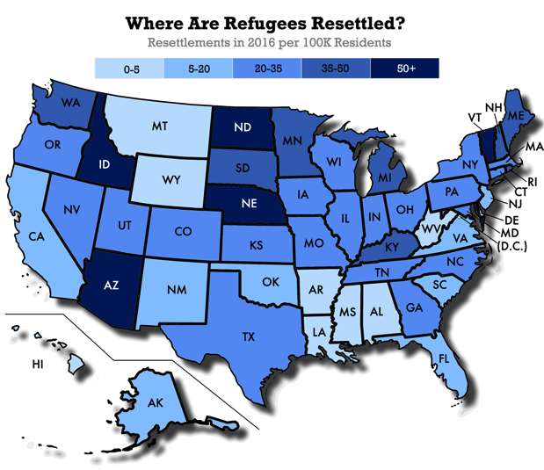
About our Learners in the US; Georgia
From war-torn countries in
Asia, Africa, the Middle East
Many with interrupted
education or no education
Experiences of trauma and
hardship
Many speak multiple languages
700,000 refugees in US; 30,000 refugees in Georgia the past 10 years
About 11 million undocumented immigrants in US, schools; 7 million in schools have undocumented parents.

Slide 12
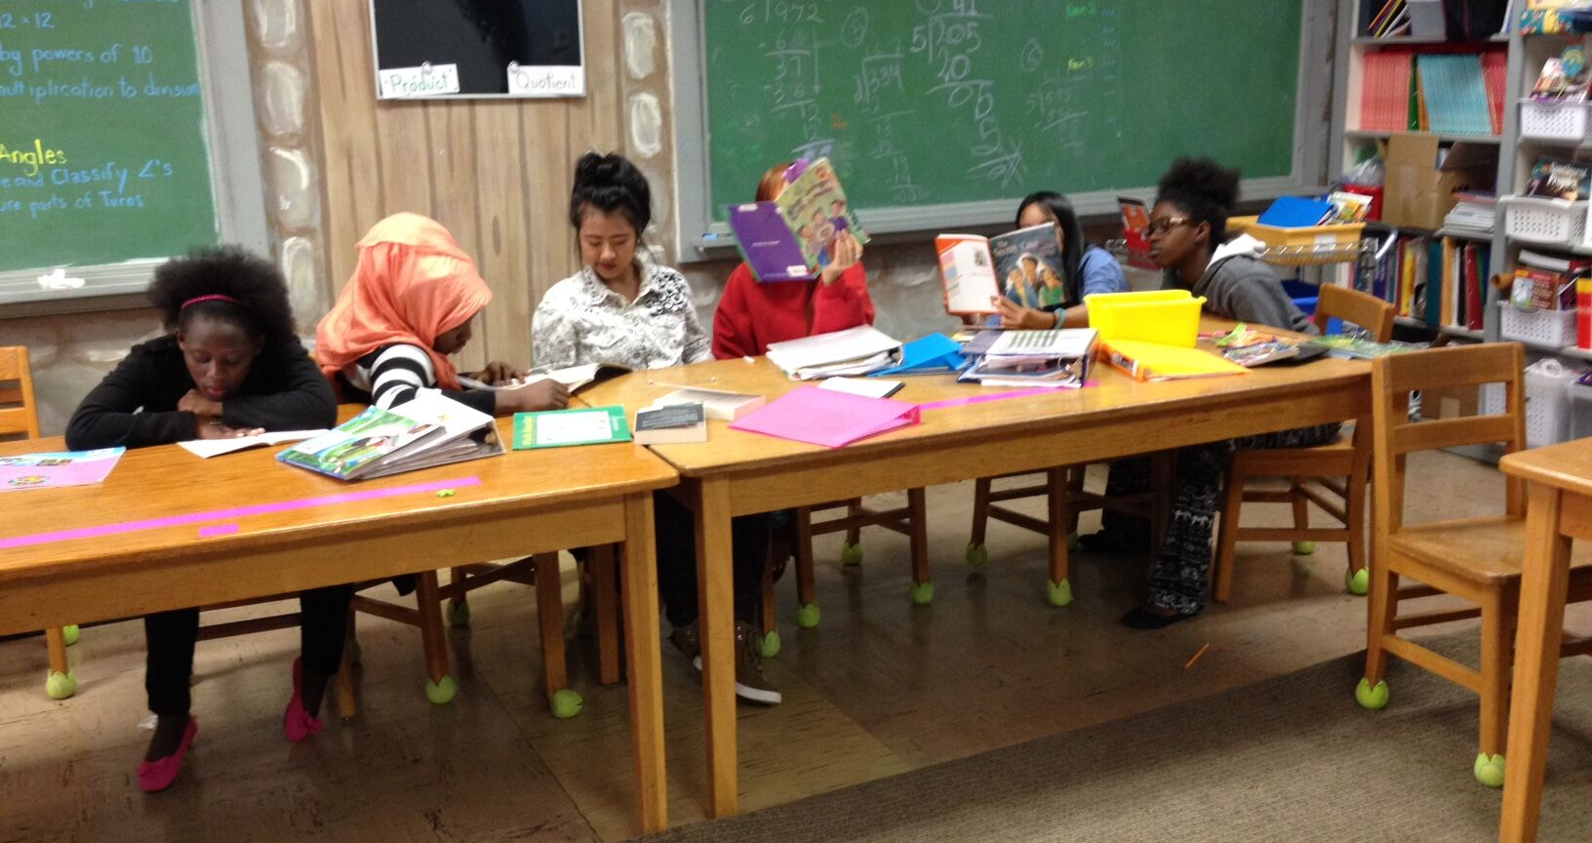
All of Our
Learners
  Are diverse in culture
  Are diverse in
  educational background
  Have many linguistic, cultural, and experiential
  resources to bring to our schools
  Are likely to have experienced trauma
Notes:
15

Slide 13
2. What Do Our Learners Need?

Slide 14
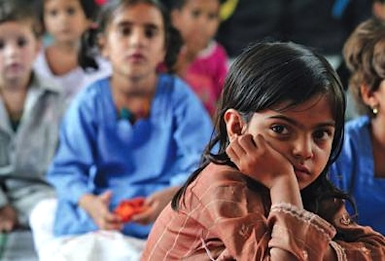
What do all newcomers need?
Safety
Cultural relevance
Effective, appropriate Instruction

Slide 15
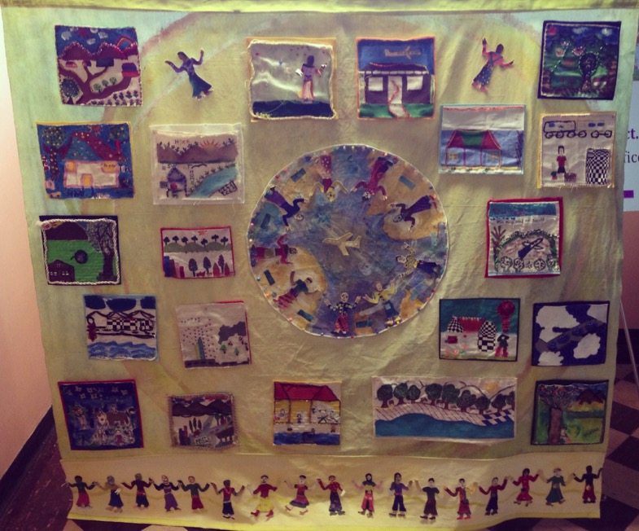
Making Learners feel Welcome and Safe

Slide 16
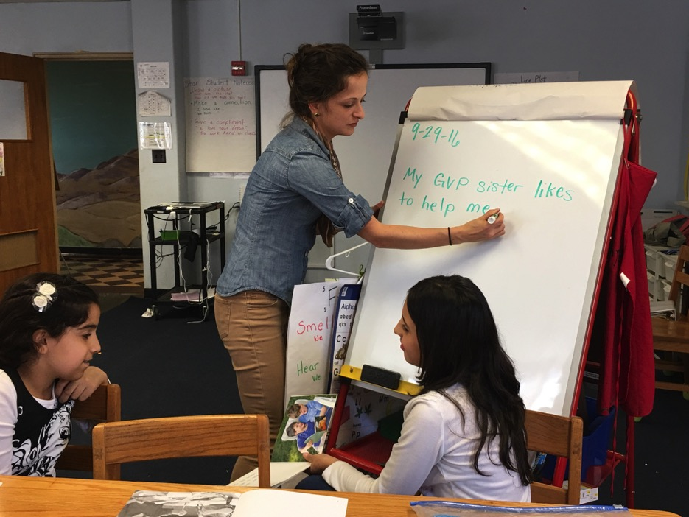
Attention to Culture: New Culture of School

Slide 17
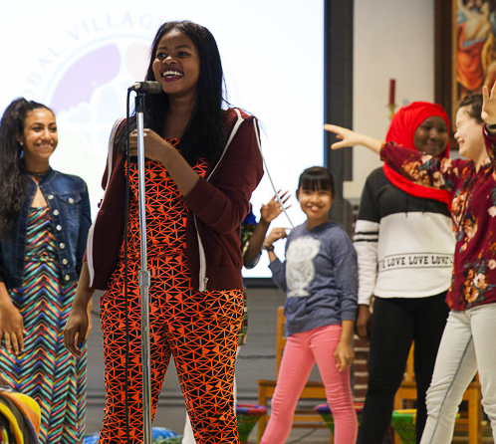
Attention to Culture:
Cultural Riches Students Bring

Slide 18
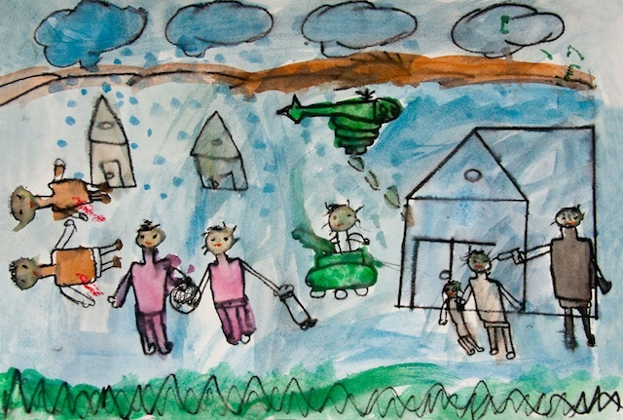
Attention to Likely History of Trauma

Slide 19
Ways we address trauma at GVP and DISC
Counselors and social workers
Cultural education of educators
Strengths-based approach: Positive learning about and respect for home cultures
Encouraging parents to engage
Notes:
25

Slide 20
3. How can we best provide quality language instruction for newcomers?

Slide 21
Models for Teaching Newcomers
Models using Target Language | Bilingual Models
L2 Pullout | Transitional Bilingual – Early Exit
L2 Class Period | Developmental Bilingual - Late Exit
L2 Content-Based | One-Way Dual Language
High-Intensity Newcomer Program | Two-Way Dual Language

Slide 22
Models for Teaching Newcomers at GVP
Models using Target Language | Bilingual Models
L2 Pullout | Transitional Bilingual – Early Exit
L2 Class Period | Developmental Bilingual- Late Exit
L2 Content-Based | One-Way Dual Language
High-Intensity Newcomer Program | Two-Way Dual Language

Slide 23
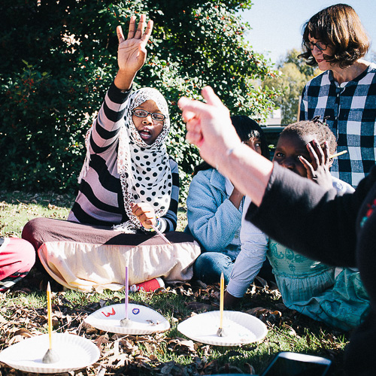
Our Model at the Global Village Project
Special-purpose middle
school (grades 6-8) for girls
with interrupted education
Strengths-based
Content-based ESOL (English for
Speakers of Other Languages) and
STEAM Program (Science, Technology, Engineering, Arts, and Mathematics)
Social-Emotional Focus
Mentoring

Slide 24
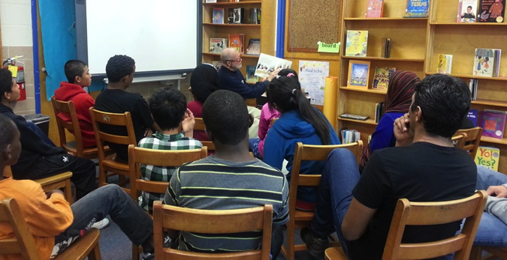
Models at the DeKalb County International Student Center
Sheltered,
content-based
High-intensity, full-day newcomer program
6 weeks-2 years in school, depending upon previous education and age
Students from many home schools bussed to the location
Students return to home school with basic skills

Slide 25
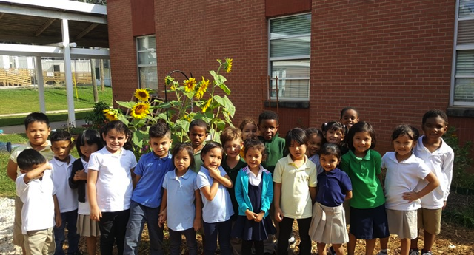
Models at other Local public schools in DeKalb
County, Georgia,
Sheltered classes
Pull-Out
Push-in
Integrated classrooms
Most teachers have training
ESOL advocates are provided to address challenges students face

Slide 26
Instructional Principles
Know your learners
Start where learners are
Provide comprehensible language
Scaffold learning, gradually increasing learners’ responsibility
Make learning active and interactive

Slide 27
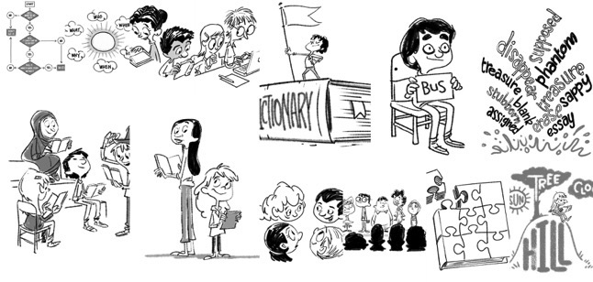
Strategies for Teaching Newcomers

Slide 28

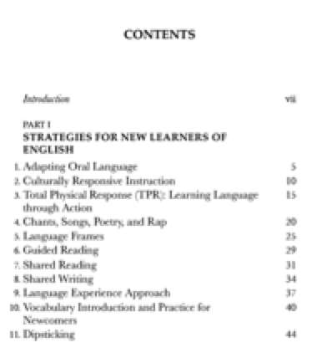

Slide 29
Differentiating in the
Multi-level Classroom
Notes:
35

Slide 30
4 Ways to Differentiate Instruction
Language use
Content offered to students
Language and literacy levels, cognitive challenge…
Process of using content (including levels of scaffolding)
Products expected from students

Slide 31
4. What additional resources can we employ?
Notes:
0

Slide 32
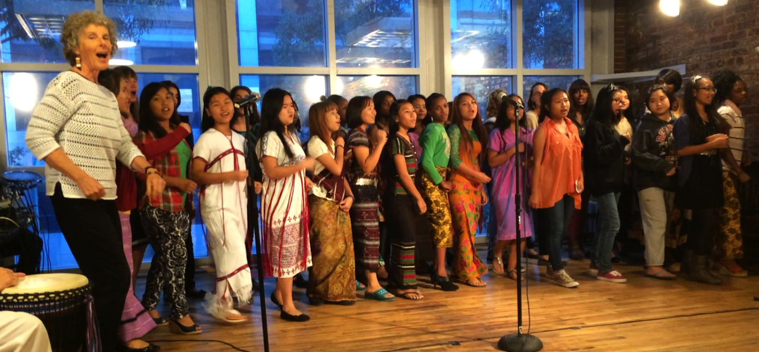
Integration of the Arts

Slide 33
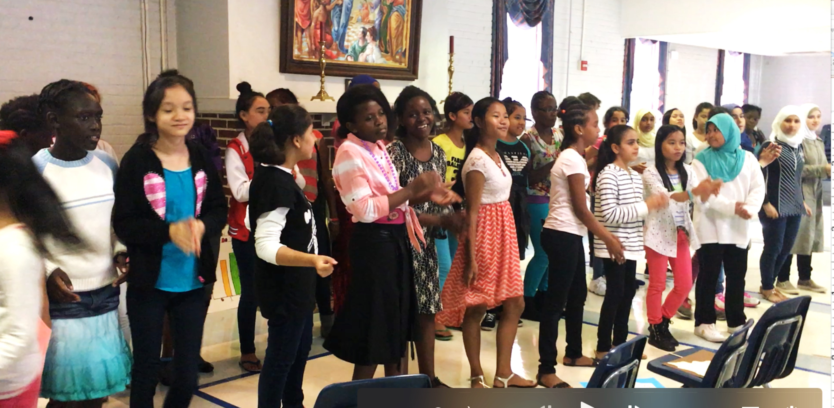

Imagine a Circle of Women
Notes:
ML

Slide 34
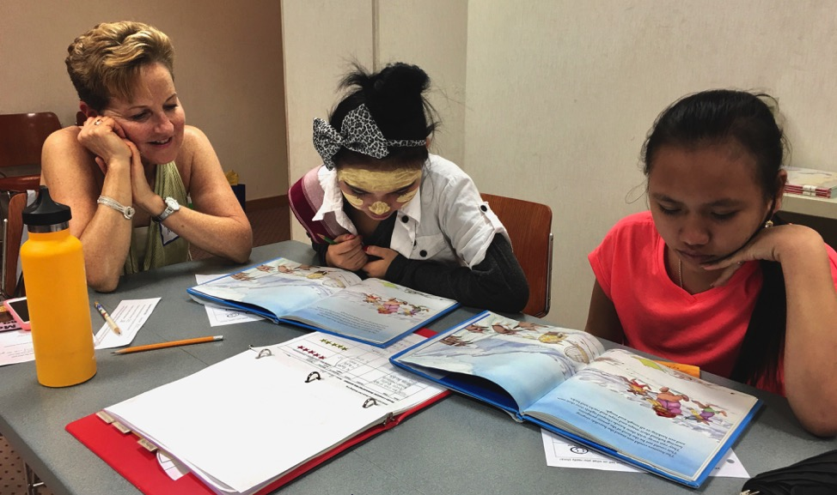
Well-Planned use of Volunteers
Notes:
Volunteers tutor in study halls, work with individuals in reading, assist content teachers, walk with girls to lunch, help with special events, …

Slide 35
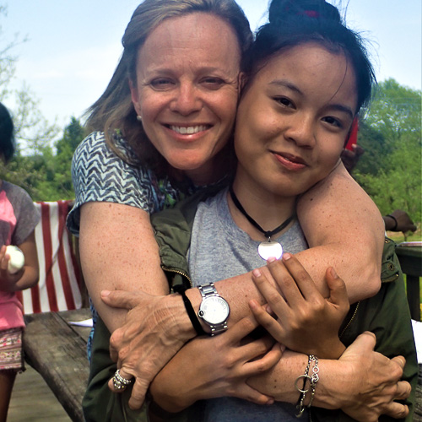
Mentors
Notes:
Students leave program with a mentoru, who helps to navigate the culture of education for students that parents struggle with. School paperwork; tutoring or finding tutoring, helping them find activities, helping with scholarsships and college admission, etc.

Slide 36
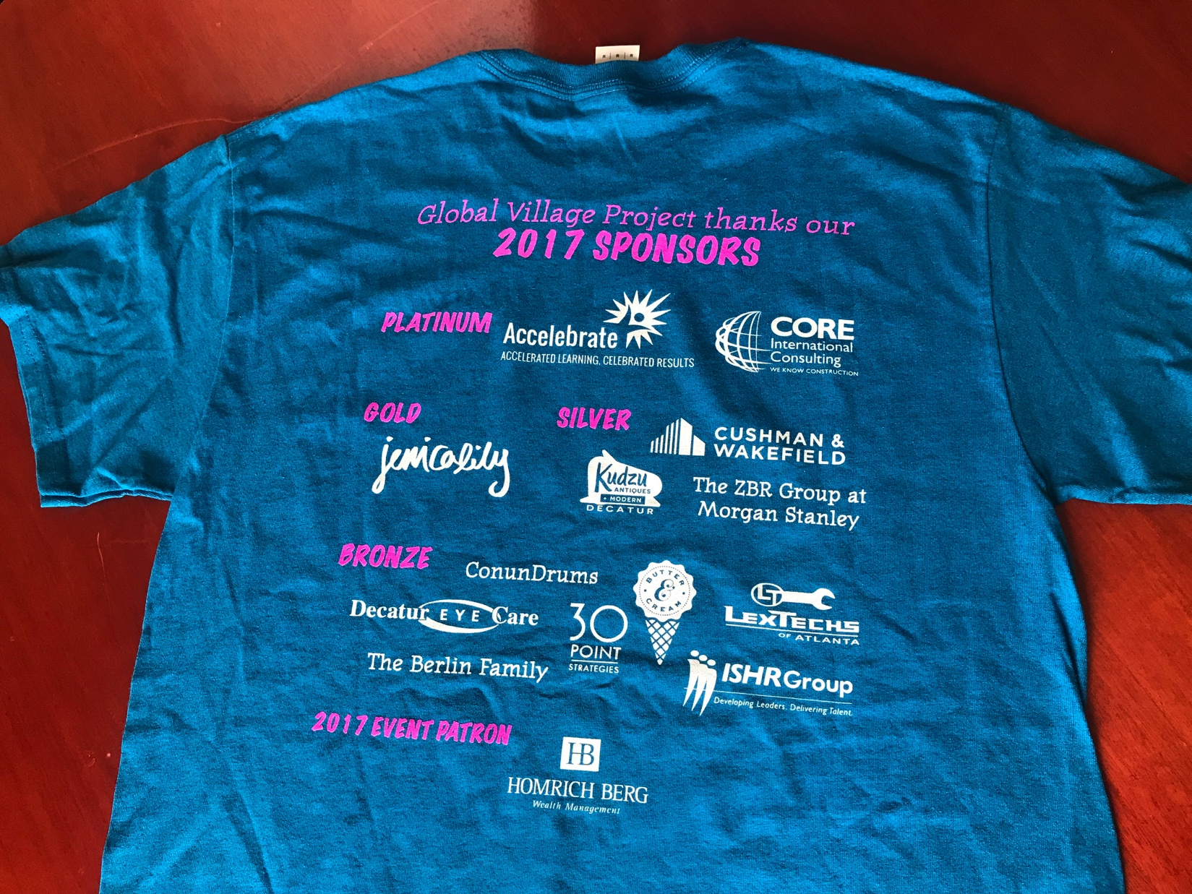
Partnerships

Slide 37
Online and Published Resources
www.mlmcc.com
Click on handouts

Slide 38
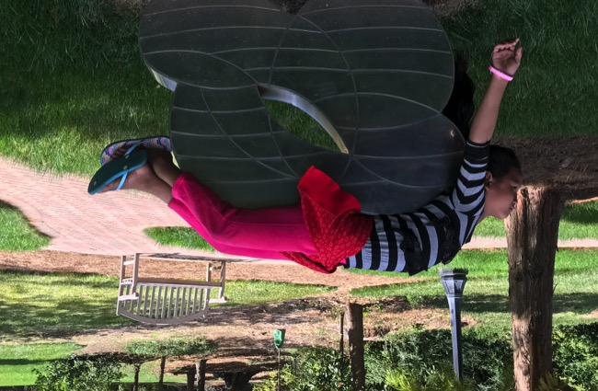
Thank you!
Slides and Resources:
  www.mlmcc.com
  Dr. Mary Lou McCloskey,
  GVP English Language Specialist
  mlmccloskey@gmail.com
  Dr. Amy Pelisserro, GVP Head of School amypelissero@globalvillageproject.org
  GVP: www.globalvillageproject.org
Notes:
40

Slide 39
Four big questions:
Who are our learners?
What do newcomers need?
How can we teach them effectively?
What other resources do we have or need?

Slide 40
We can make a difference:
Celebrating Success

Slide 41
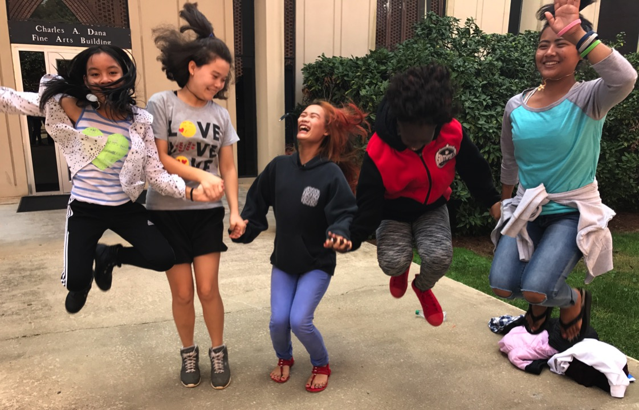
Voices of our Alumnae

Slide 42

Alumna from Burundi
“Where are you from? It is a
simple question to most people,
but I struggle to answer it. I felt
like I belonged at GVP. No longer
did I feel out of place, since all of
my fellow students had different
backgrounds. For me, home is
not a physical place, it is people. I am from anywhere and everywhere there are caring, kindhearted, compassionate and benevolent people. I am a global citizen and the future of the world.”

Slide 43
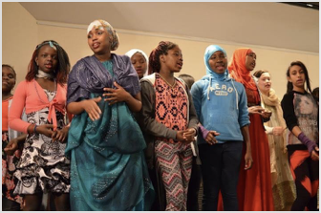
Karen Alumna, from Burma
In my country, most
of my people are shy
and afraid to speak
in public. When [my
sister and I] came to
GVP, we learned
to have confidence.”

Slide 44
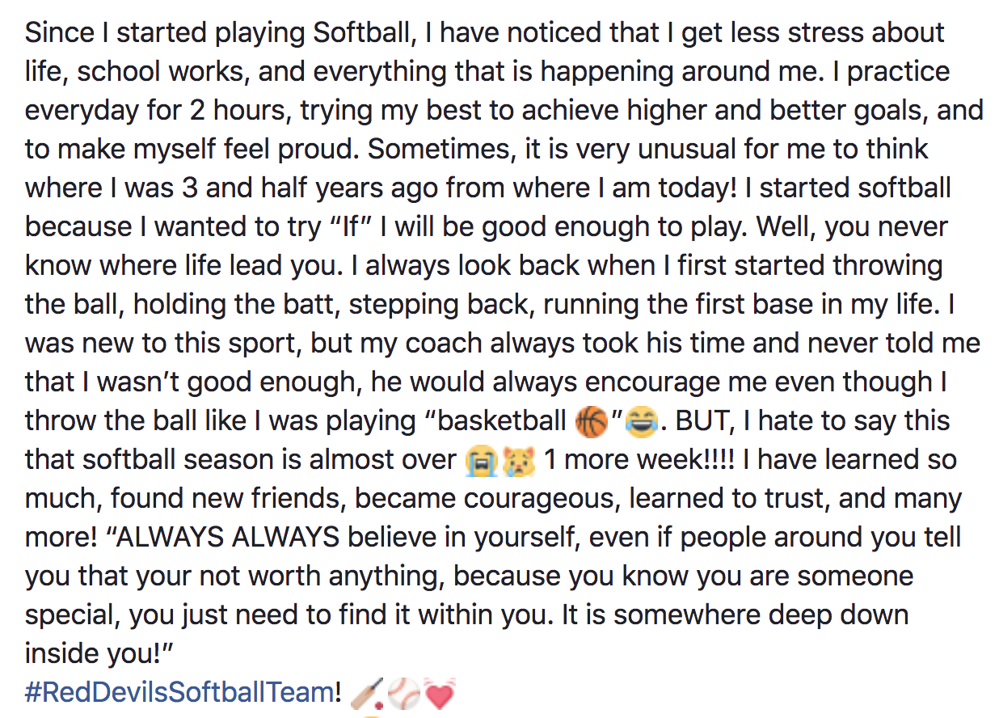
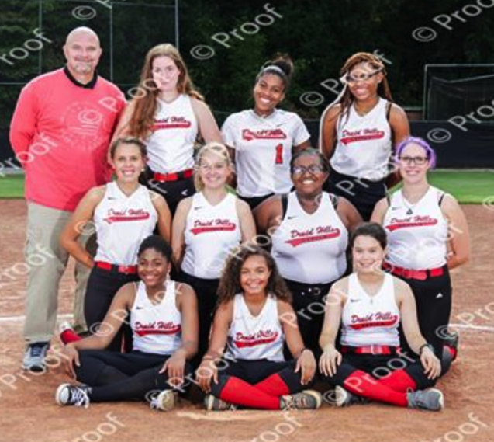
Alumna from Afghanistan

Slide 45
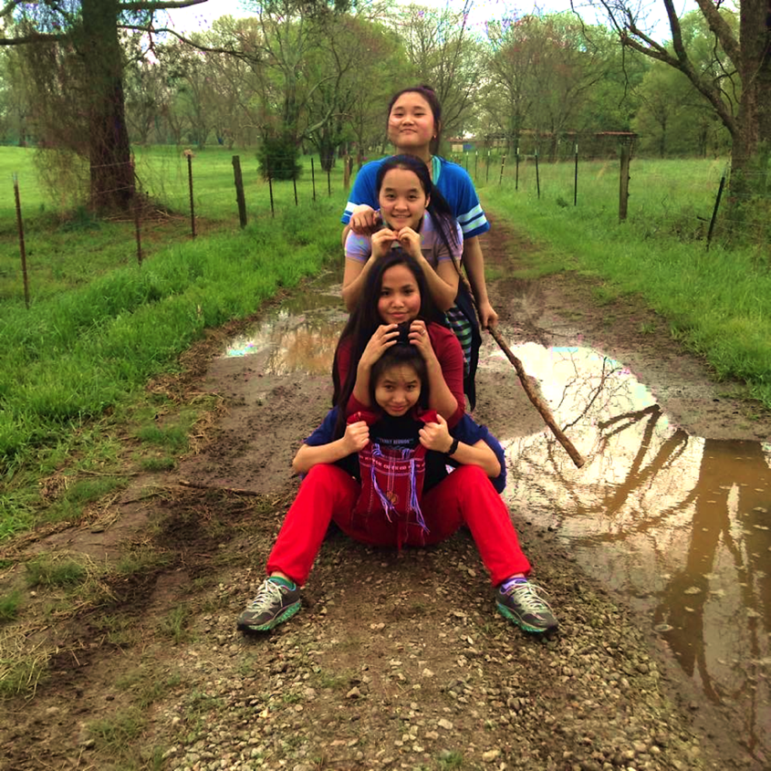
90% of alums in high school or college; succeeding at grade level
18 alumnae in college
College scholarships
First 2 college graduates in spring of 2018

Slide 46
Thank you!
Slides and Resources:
  www.mlmcc.com
  Dr. Mary Lou McCloskey,
  GVP English Language Specialist
  mlmccloskey@gmail.com
  Dr. Amy Pelisserro, GVP Head of School amypelissero@globalvillageproject.org
  GVP: www.globalvillageproject.org
Notes:
40

