Slide 1

Texts & Talk: Tutoring in trying times
Dr. Amy
February 11, 2021

Slide 2

Introductions: Context & Connections
My experiences:
Mom to 2 high school girls
Certified English teacher for 25+ years
Refugee Literacy Tutor/Volunteer
Teacher & Head of School at GVP
GVP mentor
Ph.D. in Teaching & Learning for Language and Literacy
My hopes and intentions for today:
To inform and inspire
To discuss:
    What we are doing? Aims for online tutors
    Why we are doing it? What research tell us
    How we do it using texts and talk? Share critical practices in reading instruction
To take questions and share in conversation
WHAT ARE YOUR HOPES & INTENTIONS?

Slide 3
WHAT ARE OUR AIMS? WHAT ARE WE DOING?
Tutor--from Old French/Latin - to guard or watch over; a person charged with the instruction and guidance of another
A good tutor:
Provides a safe space for learning and questions
Creates connections and bonds; forms relationships as foundation for learning
Makes learning meaningful and relevant to the lives of students; centers on students and shows concern (advocacy)
Supports and stretches students in learning

Slide 4
WHY ARE WE DOING THESE THINGS?
We want to make a difference in the lives and learning of our students.
So, we need to know what the research shows and tells us about learning:
Positive relationships (especially with teachers) are the number one factor in student success time and time again in study after study.
Students experiencing trauma or who feel disconnected and defeated will be less likely to engage in meaningful learning; our flight or fight responses (high stress) keep us from full engagement and understanding.

Slide 5
WHAT else DOES RESEARCH TELL US?
Learning is a social activity; we learn best by working closely with more knowledgeable others who support us (provide scaffolding) and gradually release that support (moderate stress, low risk).
New material must be relevant (connect to information already stored in the brain) and reachable (ZPD).
Active engagement through multiple modes in learning helps increase connections and increases memory (reading, writing, speaking, singing, seeing, creating, visualizing, moving).

Slide 6
WHY FOCUS ON READING?
Reading is fundamentally tied to learning today. Being a good reader is required in all subject areas and in almost all aspects of modern life.
Increasingly, new research across many countries is showing that the best predictor of future education achievement and life success is reading ability.
Good readers have higher self-esteem, are more confident, and are more capable learners.
Reading to and with students has been shown to increase vocabulary, meaning making, and language fluency.
Reading creates connections and opens doors to deeper comprehension, critical thinking, conversations, relationship building, and mutual learning.
Reading can be an excellent catalyst for imagination and creative engagement in multiple modes. Helps students become empowered creators, writers, artists, and learners.

Slide 7

HOW DO WE DO IT?
CRITICAL PRACTICES
1. Get to know your students. Spend time just talking with them about their days, their interests, their struggles and accomplishments in school.
2. Read together.
3. Help students understand and make meaning from what they read.
4. Talk about what you read. Ask questions and encourage students to go deeper and connect what is read to their lives and to what they already know.
5. Give students strategies for understanding unknown words and making sense out of what they read on their own.

Slide 8
Why should tutors read aloud?
Provides an opportunity for students to hear a text read fluently; model of fluent reading and oral phrasing
Allows students to listen at a higher level than if reading on their own and decreases their stress
Teaches words in context, not in isolation
Increases student access to more sophisticated vocabulary, ideas, and language patterns
Provides opportunities for authentic talk and builds rapport between tutor and student
Facilitates interest in books and a desire to be a reader
Demonstrates the relationship between print and meaning
Increases comprehension and builds connections
Invites students to make predictions and inferences

Slide 9
HOW do WE help students become better readers?
1. Read together and out loud. Choose books that are at or just above the student’s level.
2. Model your own thinking and meaning making for students.
3. Help students learn to be better decoders.
Tell them and show them (using technology) what new words mean.
Teach them about the sounds that English letters make.
Teach them to recognize simple sight words. These can be memorized.
Show them how to use cues in the books to help them understand (such as pictures).
4. Engage in meaningful conversations around texts.

Slide 10
Reading Strategies
1. Choose the right books:
  5 finger book test: You can teach students that if there are 5 words on one page of text that they cannot read or decode, then they need to find a book at a lower level.
  Look at vocabulary load, themes, representation of cultural diversity and student interest.
2. Review the text ahead of time (if possible) and introduce pre-reading strategies: look at cover, do a book walk through the pages, makes guesses about what the book is about, discuss any repeating words or important new vocabulary words, etc.
3. Read together and out loud. Options: Echo reading, duet/paired reading, turn-taking
4. Model and teach decoding strategies: Recognize common sights words by memory; relate sounds to letters; focus on meaning by looking at context cues and clues; use a text highlighter or finger to point to text/words while reading
5. Teach phonics strategies: Tap/clap out syllables; recognize rhymes and learn rhyming word families (-an, -at, -op, etc.); learn letter-sound connections
4. Notice and make opportunities for student participation, engagement, questions, and discussion.

Slide 11

Reading comprehension questions (a start)
Pre- or Post- reading questions:
What do you notice about the text? Is there anything interesting or surprising to you?
What do you observe as you look at the following: cover, pictures, bold or italicized vocabulary words, title, headings, subheadings?
Why do you think the author wrote this? (to entertain, make you laugh, inform you, teach you a lesson, instruct you on how to do something, etc.)
Post-reading questions:
What important details did you find in the reading? Were there any parts (words, pictures, phrases) that stood out to you or caught your attention?
What questions did you have while reading?
How would you summarize the main point of this using your own words? Or, can you tell me the story as you understand it?
Did the reading make you think of anything from your own life? Or, did you see any connections to songs, movies, or other books you have read?

Slide 12
Reading & other resources
Information on Read Alouds:
http://www.readwritethink.org/professional-development/strategy-guides/teacher-read-aloud-that-30799.html
Reading Strategies:
https://www.edutopia.org/article/6-elementary-reading-strategies-really-work
Tutoring Strategies & Resources:
https://www.readingrockets.org/article/tutoring-strategies-primary-grades
https://www2.ed.gov/teachers/how/read/tutors.html
https://www.readinga-z.com/tutoring-mentoring-packs/
Teaching Phonics:
https://us.letterland.com/letter-sounds
https://www.literacyideas.com/how-to-teach-phonics
https://www.readingrockets.org/teaching/reading-basics/phonics

Slide 13
A few final suggestions
Stay focused on the positive. Celebrate the small successes.
Have fun!
Encourage and praise as often as possible.
Be patient.
Be open to learning, new perspectives, and alternative ideas. Engage students in questions and conversations.
Encourage students to self-correct and stretch. Help them use strategies to figure things out on their own. Remind them that you are there if they need you.
Work together with other tutors. Share your stories, successes, and frustrations with other tutors and continue to learn together.

Slide 14
Questions & Conversation

Slide 15
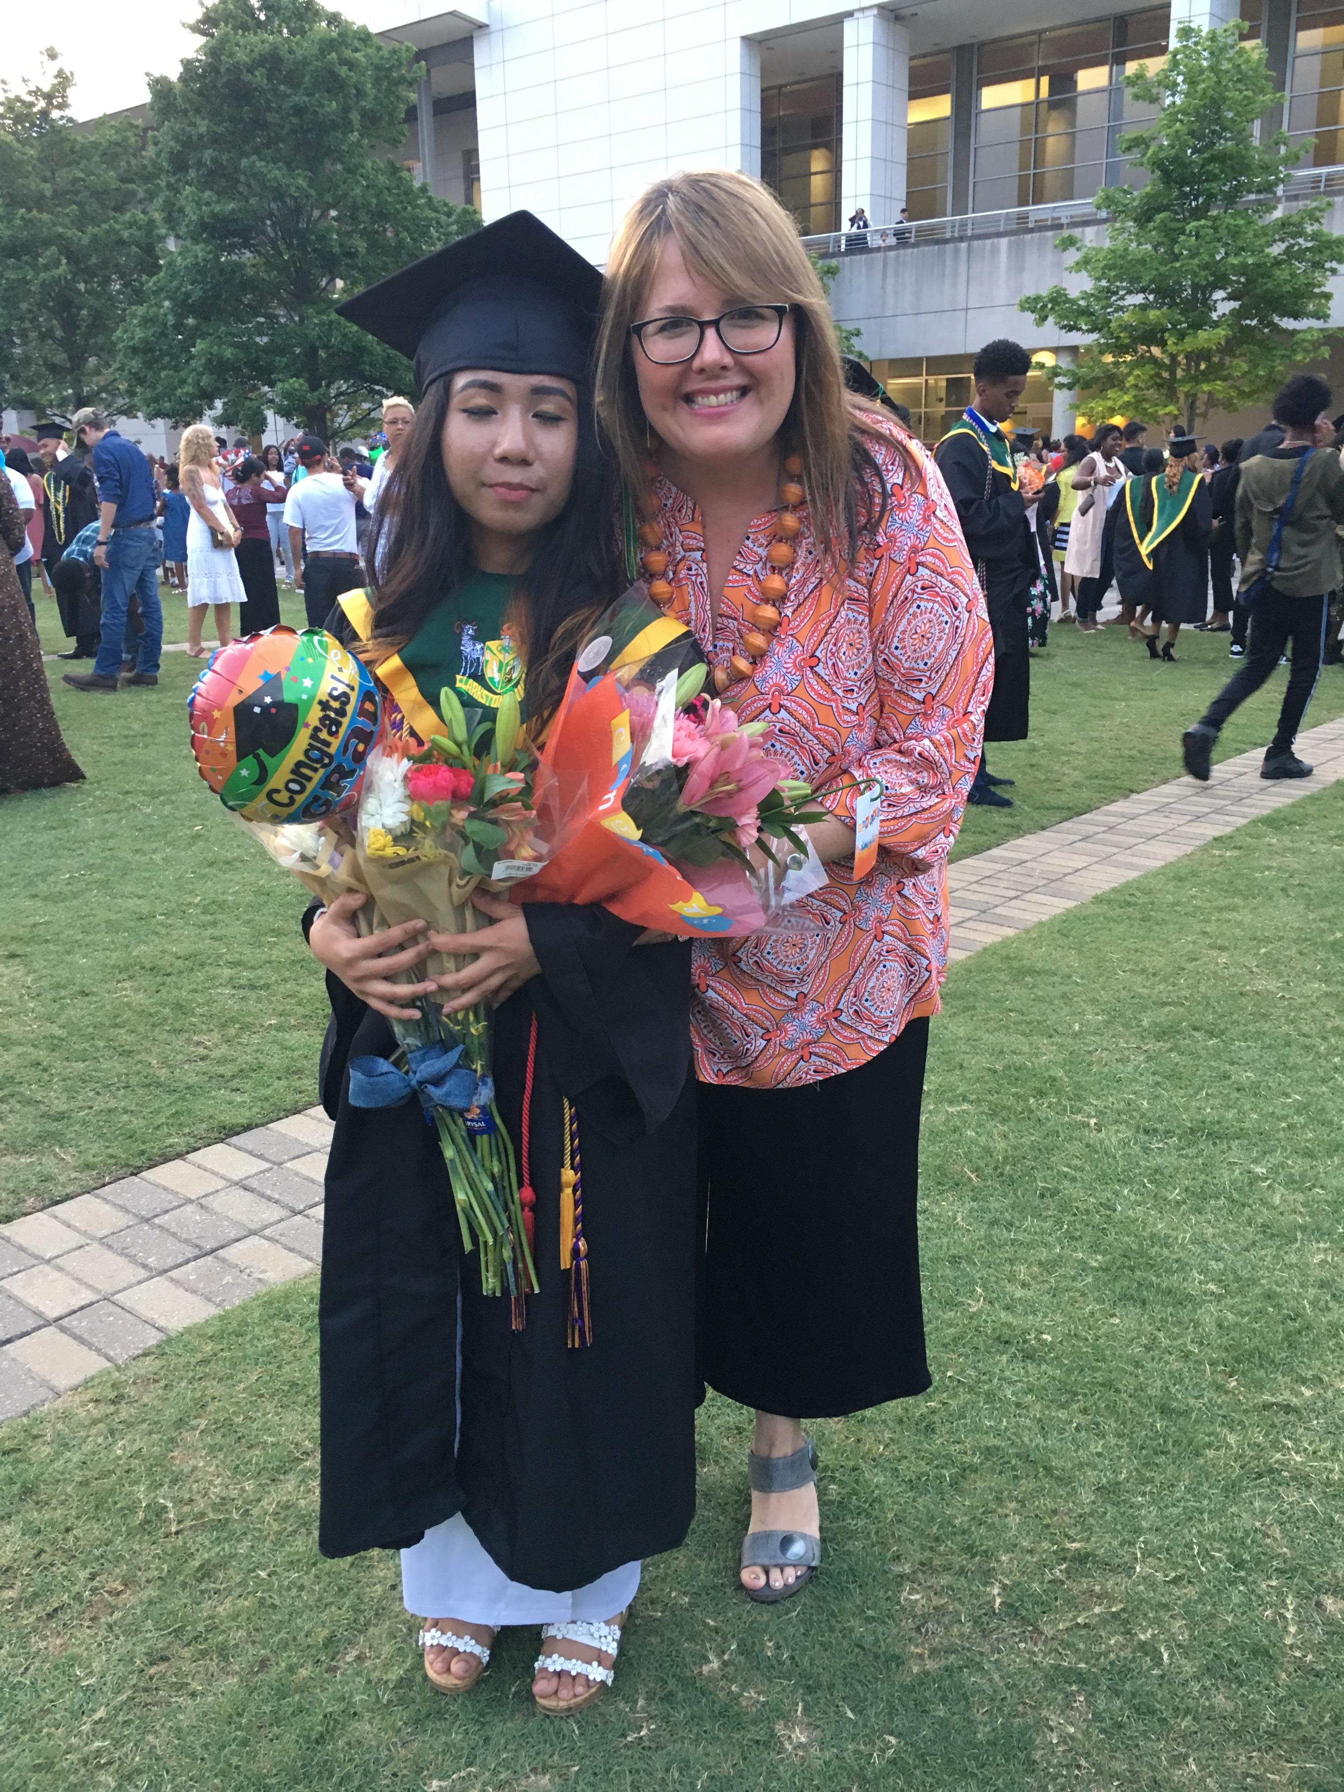
Thank you!
Thank you for the time, energy, effort, and care you give to the students you tutor. Thank you for having me here today! I hope this information is helpful and provides you with some information and inspiration as you do a great deal to make a difference in the lives of the people you are serving.
a_pelissero@yahoo.com

